Slide 1

Heatwave Pilot
Thessaloniki
19-20/11/2018

Slide 2
Heatwave pilot
Date:19 and 20 November 2018
Place: Hellenic Rescue Team Headquarters, Thessaloniki Greece
More than 50 participants (volunteers, citizens, members from Civil Protection, members of the Consortium)
19/11 Training Day
20/11 Pilot implementation

Slide 3
Goals – Challenge of Heatwave pilot
Today in Greece:
There is not a unified model or authority to coordinate the heatwave.
There is not a Joint Rescue Coordination Center (JRCC).
Goals:
test the early warning system alert
test the beAWARE platform and mobile application
test text, image and video analysis
test the PSAP system
test first responders management

Slide 4
Use Cases – Heatwave pilot Setup
Definition of Use Cases and User Requirements for the Heatwave scenario
Discussion with technical partners
Selection of Use Cases to be tested based on maturity level of platform
  Heatwave Forecasting alert
  Management of traffic emergencies
  Management of Places of Relief
  Response to Power Outage

Slide 5
Use Cases – Heatwave pilot Execution
  Selection of heatwave pilot demonstration site and participants
  Training of the participants
  Storyline Setup
    Legacy tools
    beAWARE platform and mobile application
  Pilot Execution

Slide 6
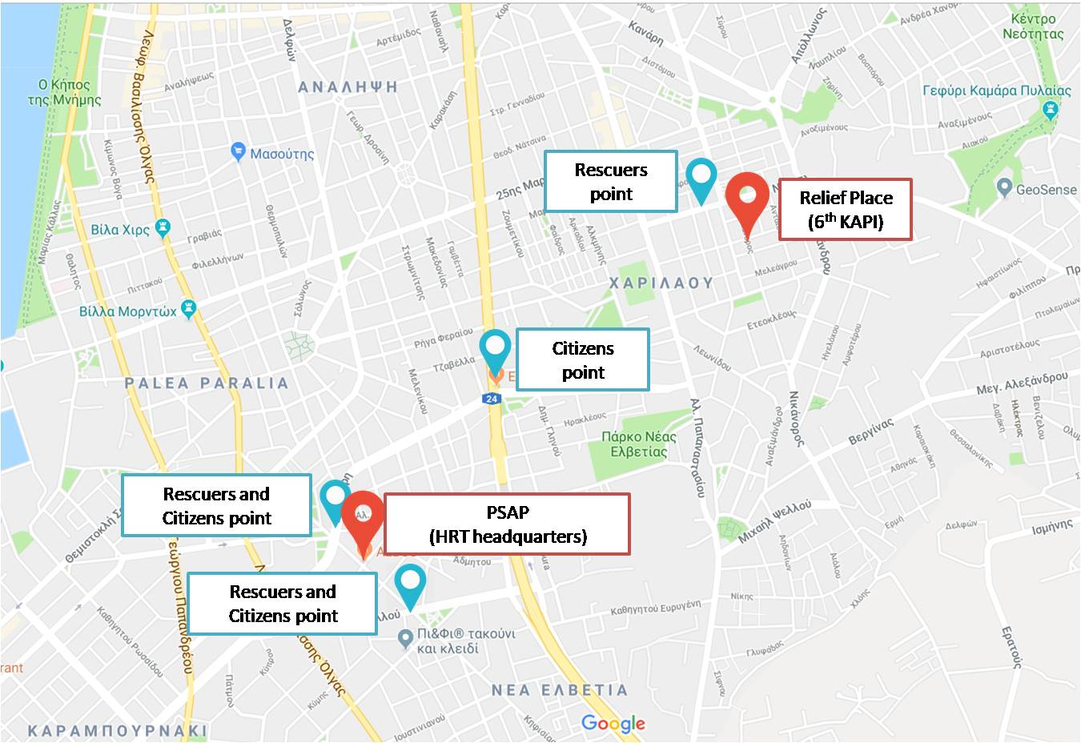
Heatwave pilot - Demonstration site

Slide 7
Heatwave pilot - Equipment & Places
Equipment:
5 VHFs
10 laptops
2 projectors
40 mobile devices
Places:
HRT Headquarters
Relief place building (6th KAPI)

Slide 8
Heatwave pilot - Participants
2 main teams
Players
  PSAP operators
  Citizens
  Rescuers
Observers – Evaluators
  Civil Protection/Rescue Organizations
  Members of the consortium

Slide 9
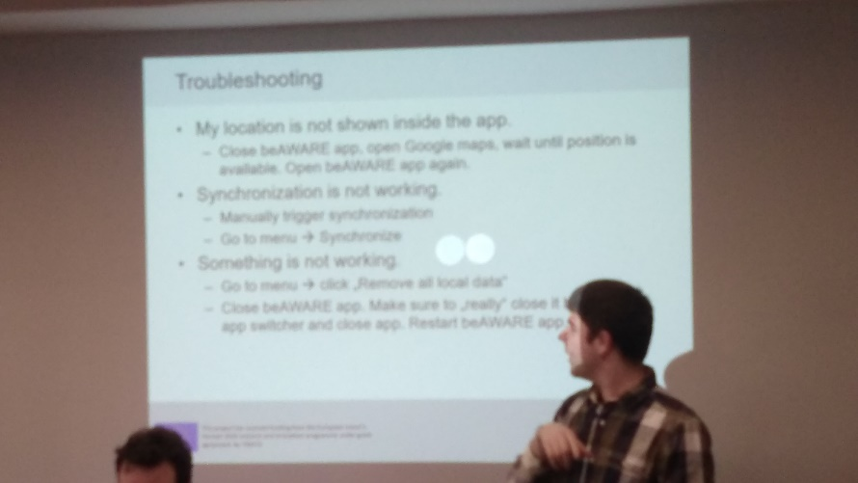
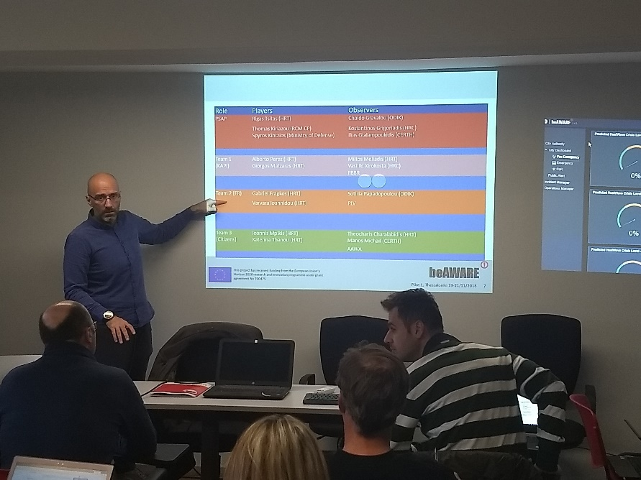
Training of the participants
1st presentation of beAWARE project
Detailed explanation of beAWARE functionalities
Heatwave pilot key points
Training of participants in:
  PSAP
  First Responders
  Citizens
  Observers/Evaluators

Slide 10
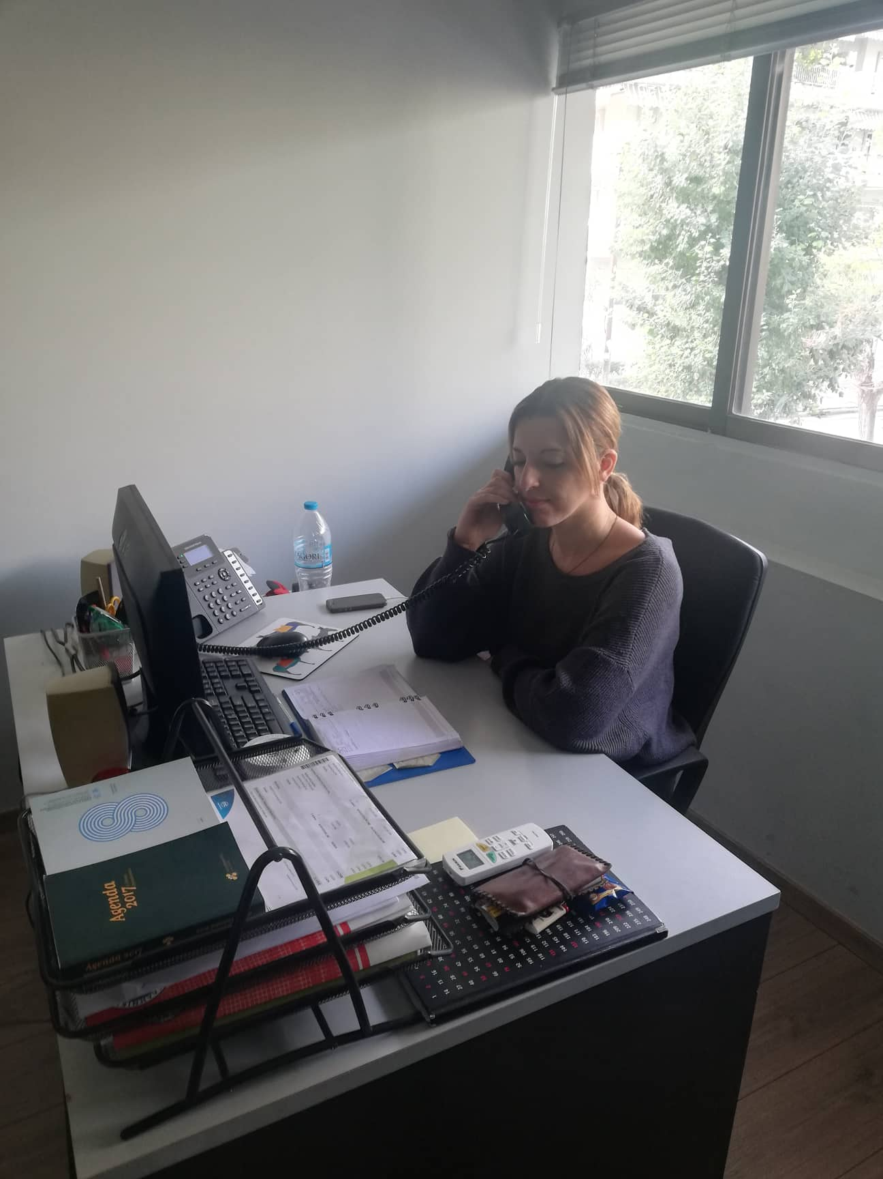
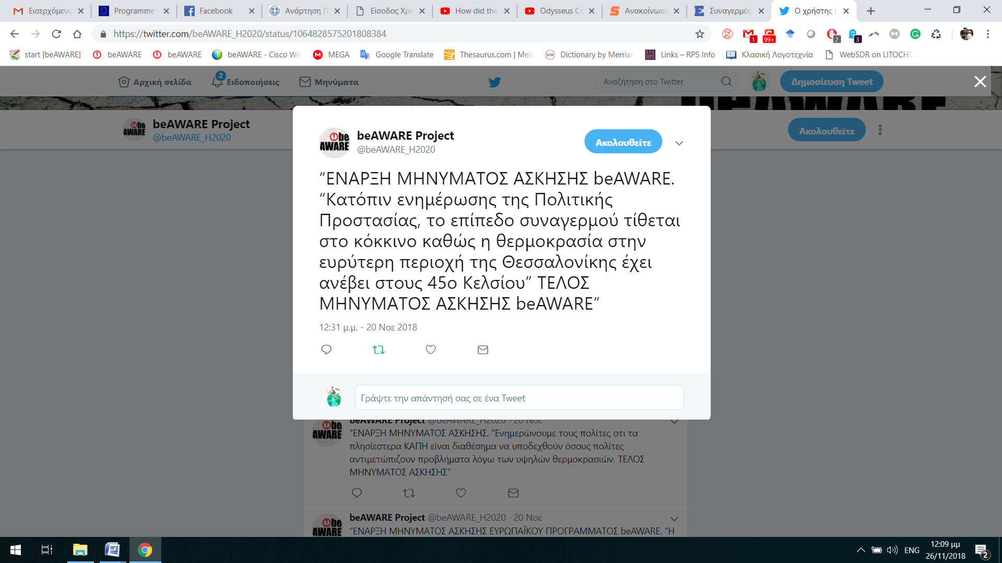
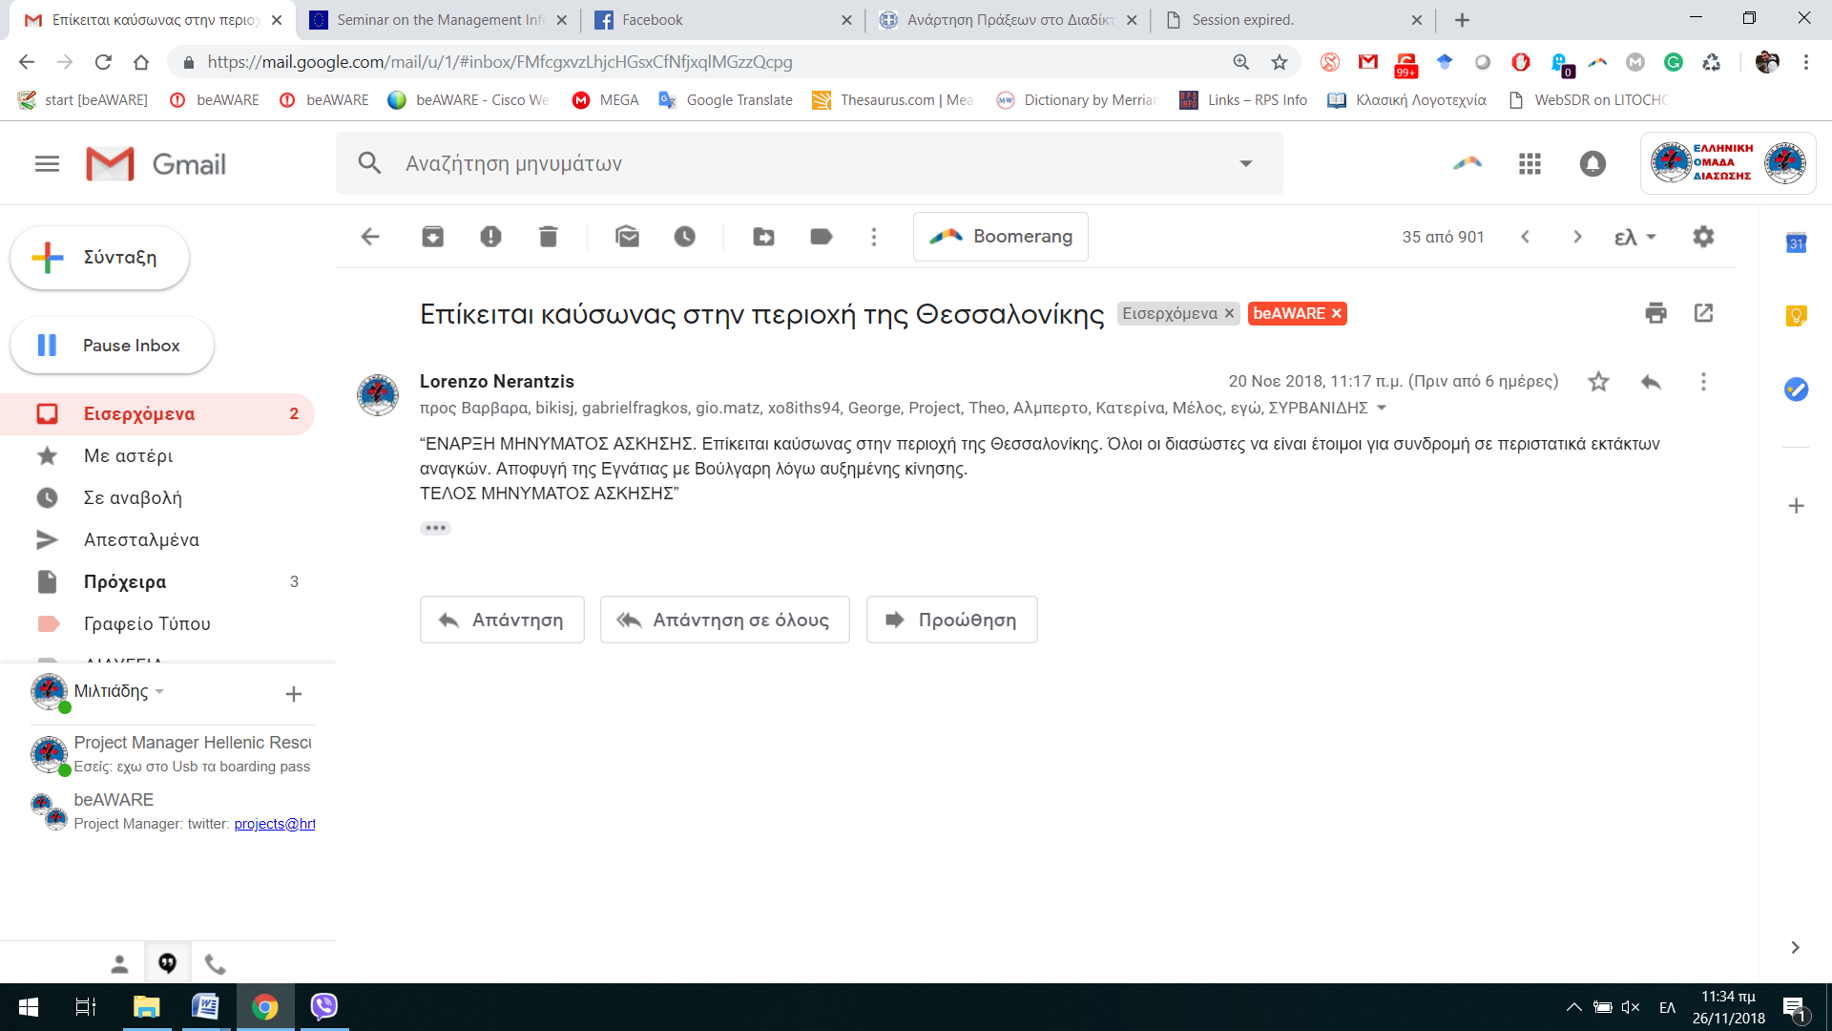
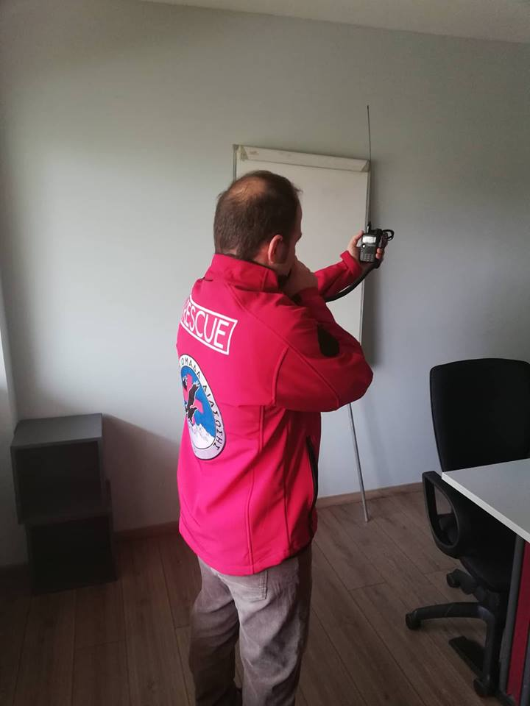
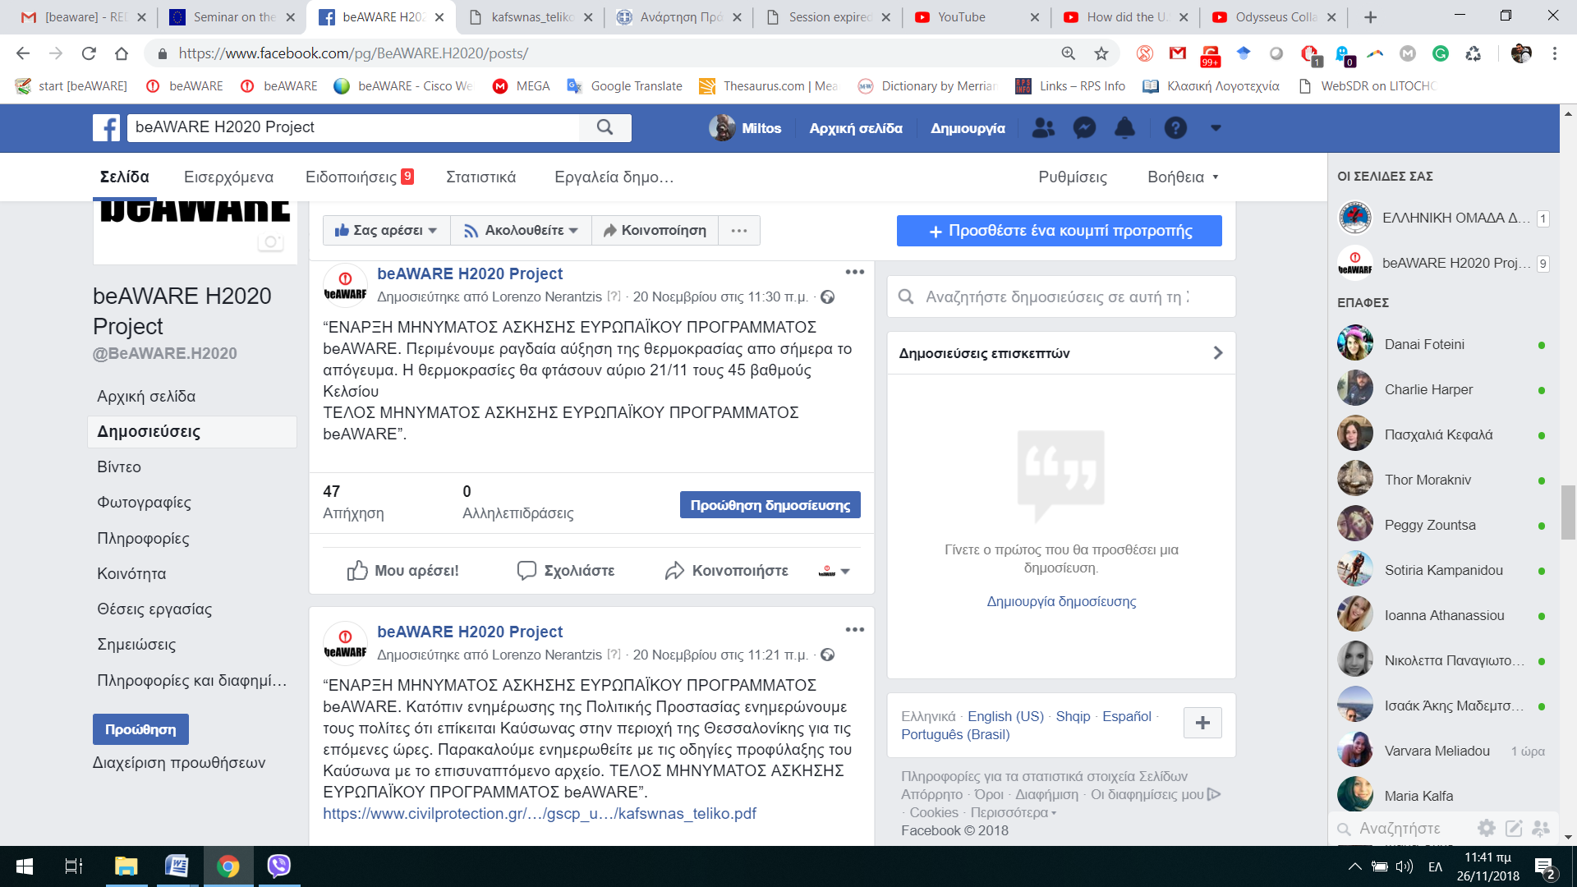
Storyline setup - Legacy Tools
Telephone
VHF
Fax
Email
Social Media

Slide 11
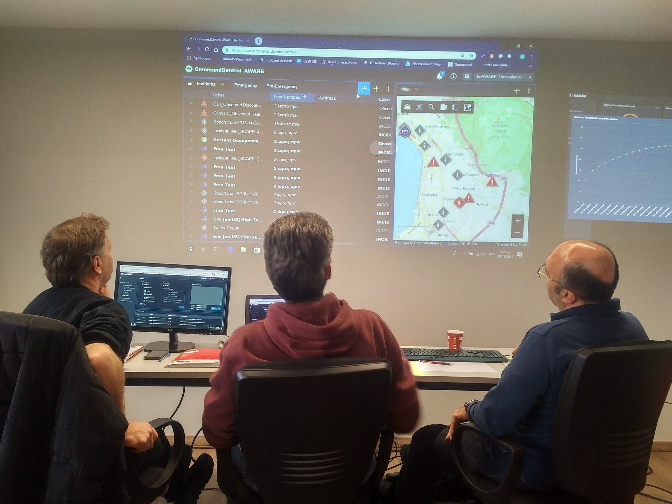
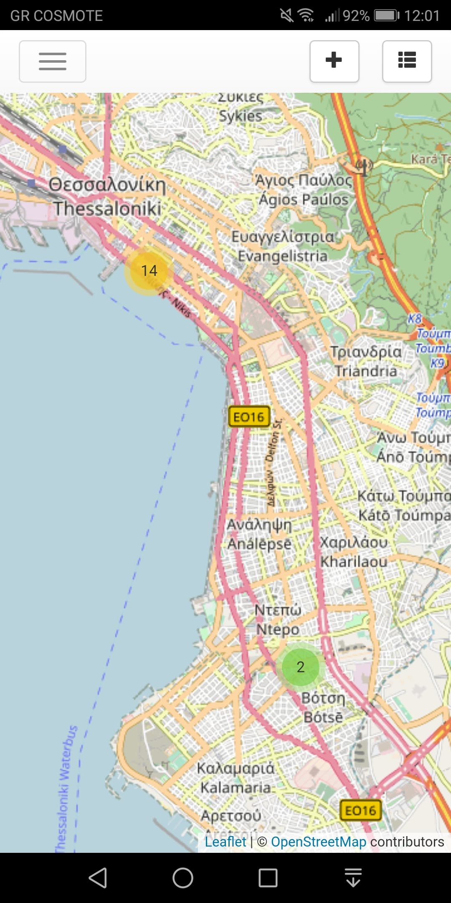
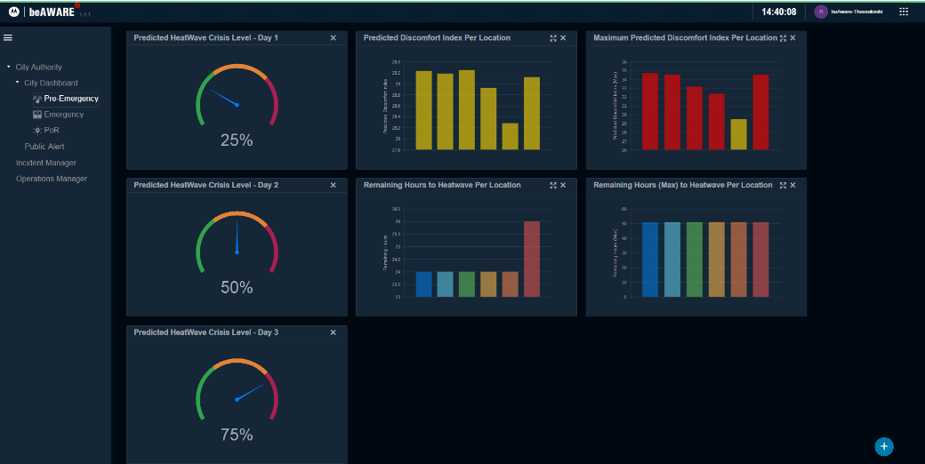
Storyline setup - beAWARE platform
Weather data
Early warning system
PSAP
Mobile application
Voice, Image, Video analysis
Traffic management
Report Generation

Slide 12
Heatwave pilot execution
Storyline of the pilot: 3 sessions
Pre Crisis: Early warning, understand the problem, send the first alerts
Traffic Jam – Power Outage: Understand the status of the heatwave, the problem of the electrical supply and the streets that are blocked
Place of Relief: Direct people to place of relief, manage the situation incident, send reports from the place of relief and directions to it.

Slide 13
Session 1 - Pre Crisis
Storyline
  Simulated Imminent heatwave
  Early Warning
  With Legacy Tools
  Early Warning (National Weather Institute)
  PSAP issues press releases.
  email to citizens and Rescuers
  With beAWARE platform and application
    Early Warning (automated)
    Real time data
    Weather data
    Send warnings and notifications to Rescuers and Citizens

Slide 14
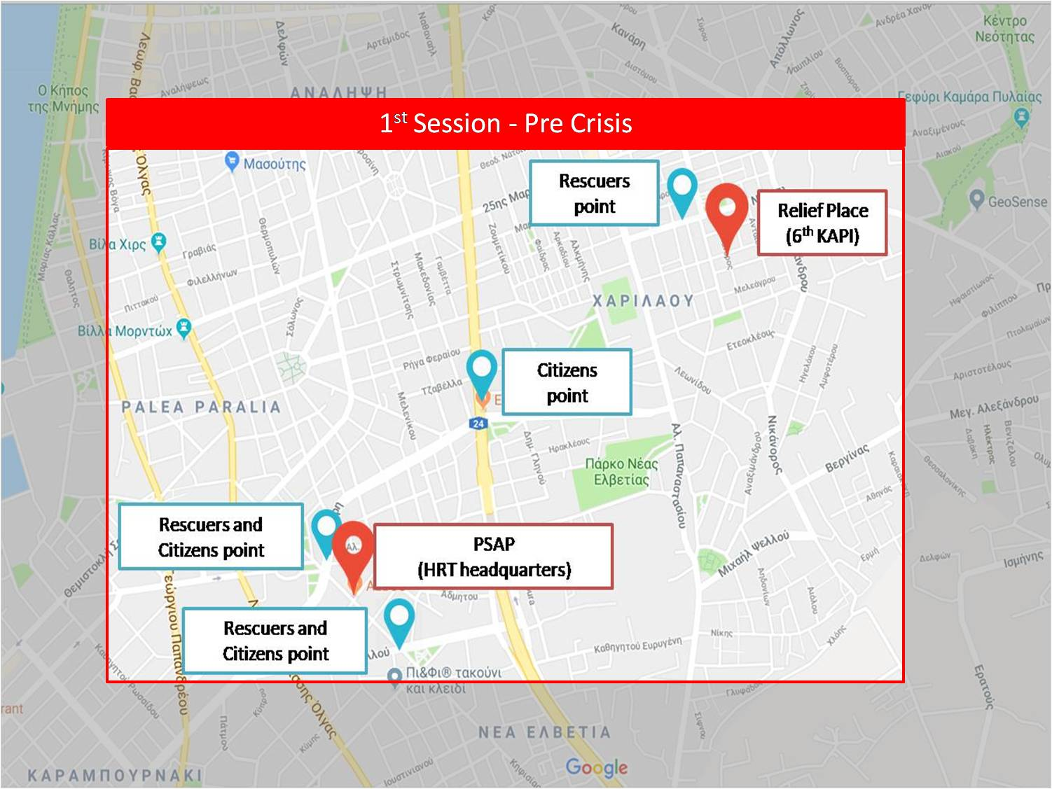
Session 1- Map Area

Slide 15
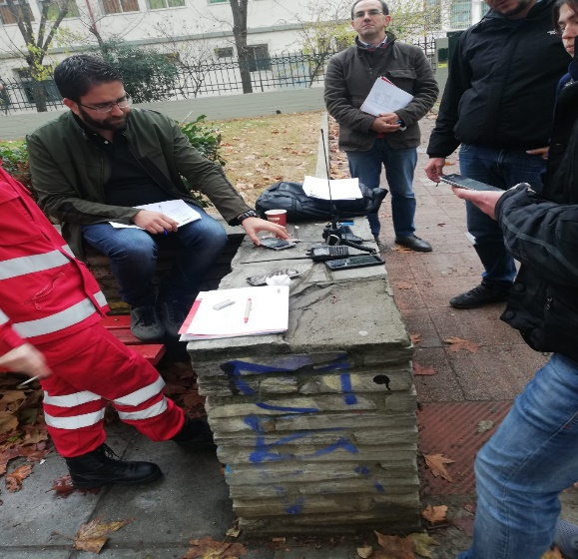
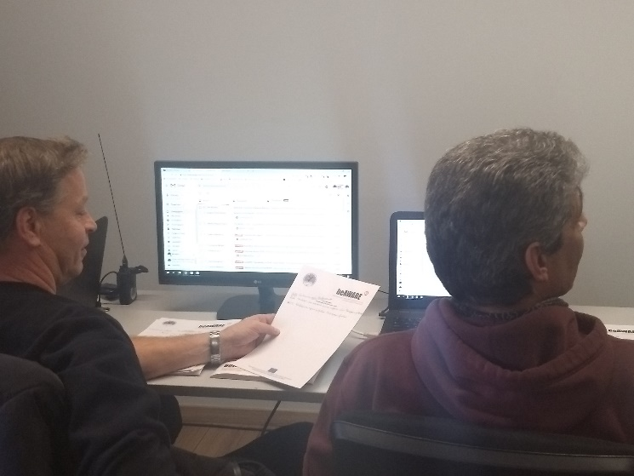
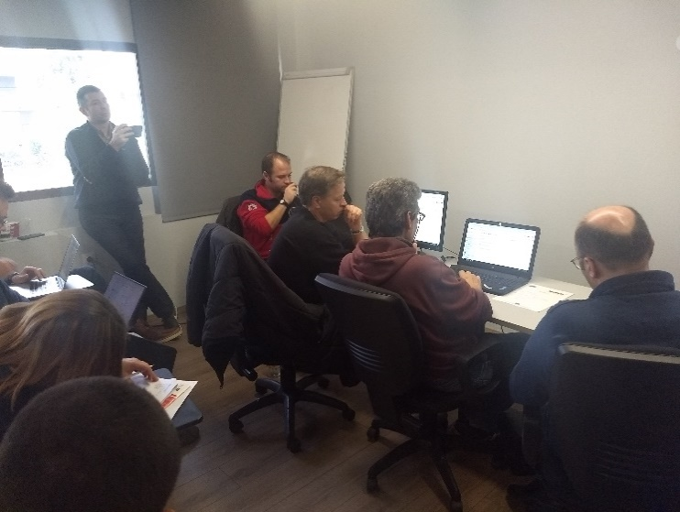
Session 1 - Legacy Tools

Slide 16
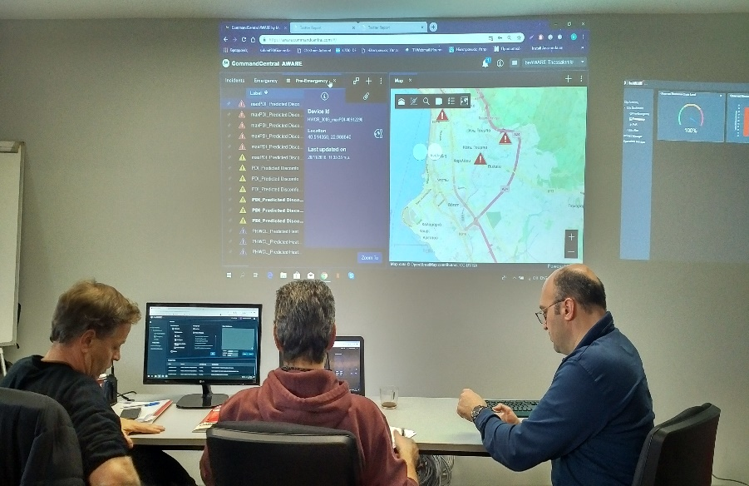
Session 1 - beAWARE

Slide 17
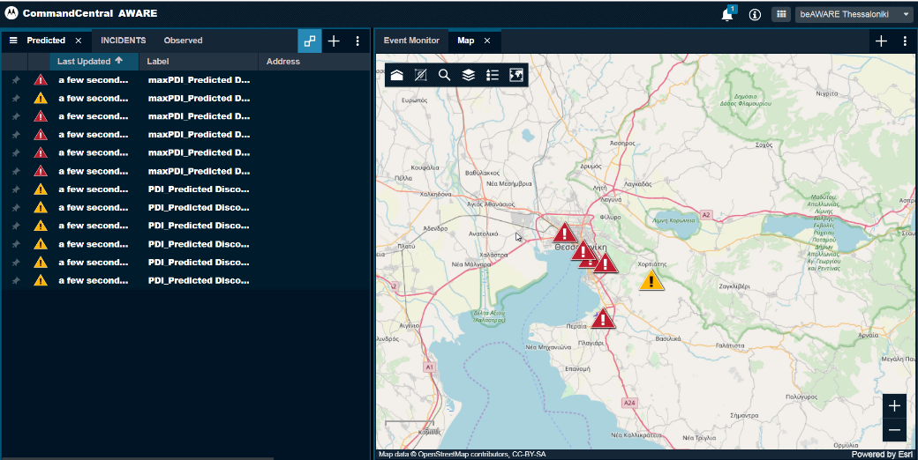
Session 1 - beAWARE
Different Locations of incidents. Different colours indicate the significance of the Predicted Discomfort Index over the population

Slide 18
Session 1 - beAWARE
1: Predicted Heatwave Crisis Level
2:Predicted Level of Discomfort Index (DI) & how many hours are needed its appearance in specific locations
3:Importance of maximum value of Predicted DI and how many hours are needed until the heatwave crisis event receive its maximum value in specific locations
1
2
3

Slide 19
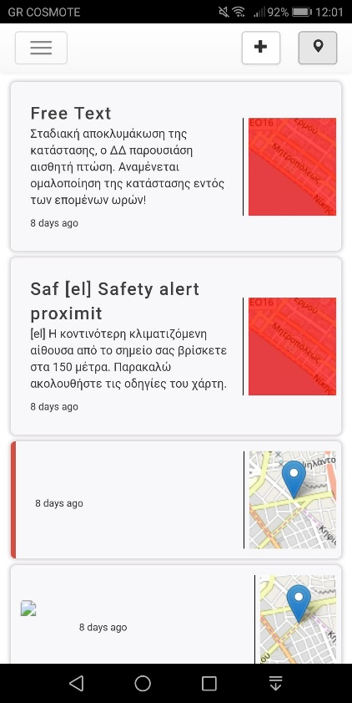
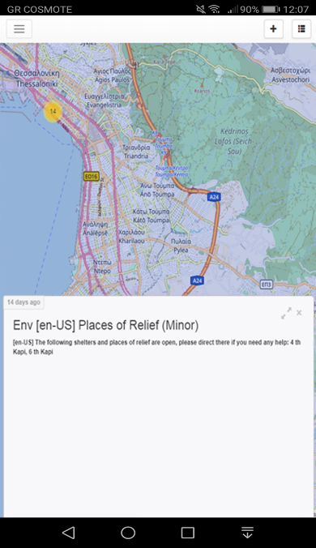
Session 1 - beAWARE
Notifications menu on mobile devices during the pilot
Example of a Public Alert received
on mobile devices during the pilot

Slide 20
Session 2 – Traffic Jam & Power Outage
Storyline
  Simulated traffic jam
  Simulated power outage
  With Legacy Tools
  Phone calls
  Social Media
  With beAWARE platform and mobile application
  Voice, Image and Video messages from citizens to PSAP
  PSAP send tasks to Rescuers

Slide 21
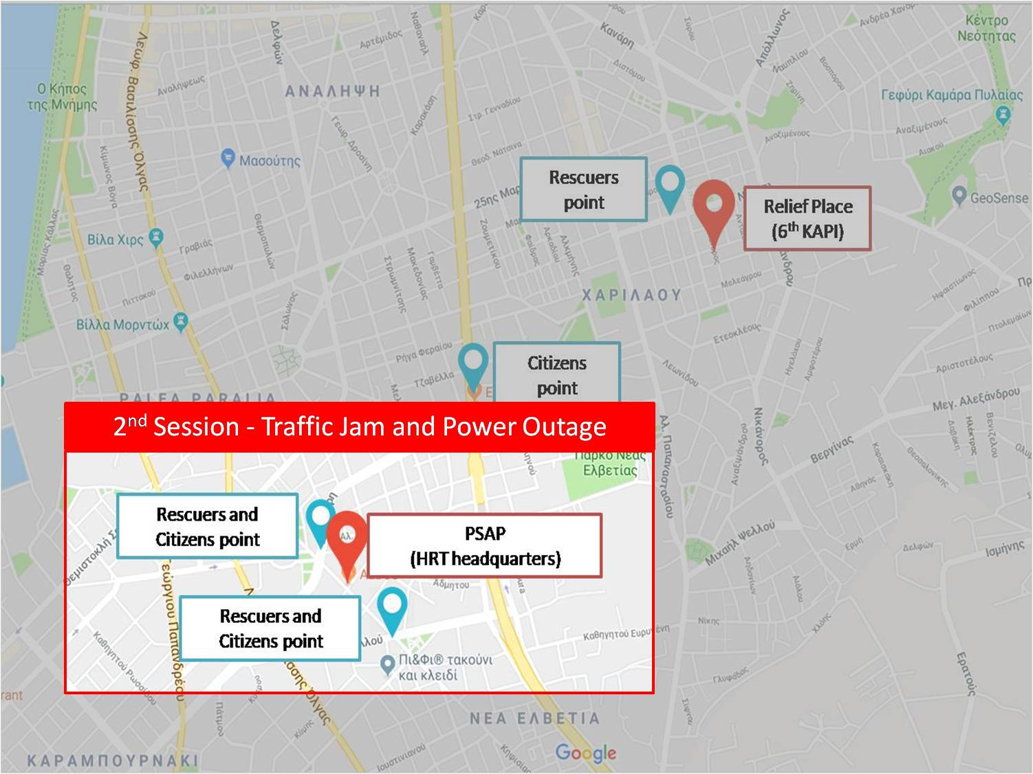
Session 2 - Map Area

Slide 22


Session 2 – Legacy Tools

Slide 23
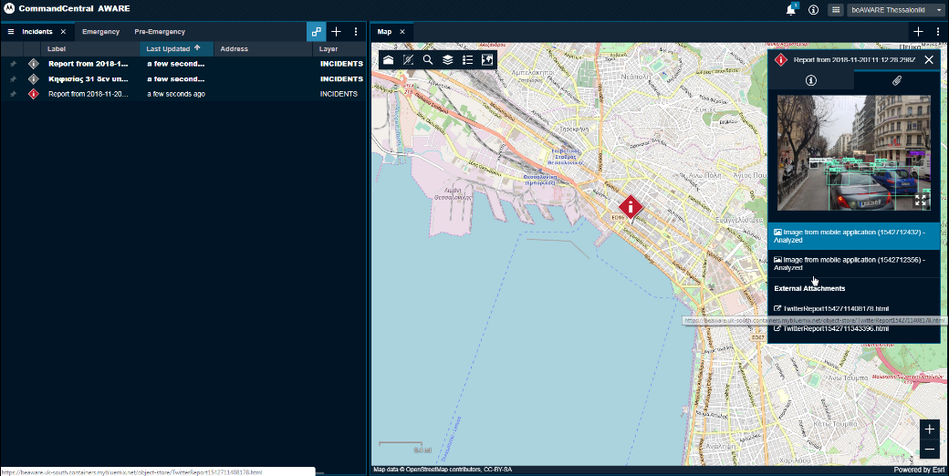
Session 2 – beAWARE
Incident report from Tsimiski street. The illustrated report contains 2 image reports and 2 twitter reports.

Slide 24
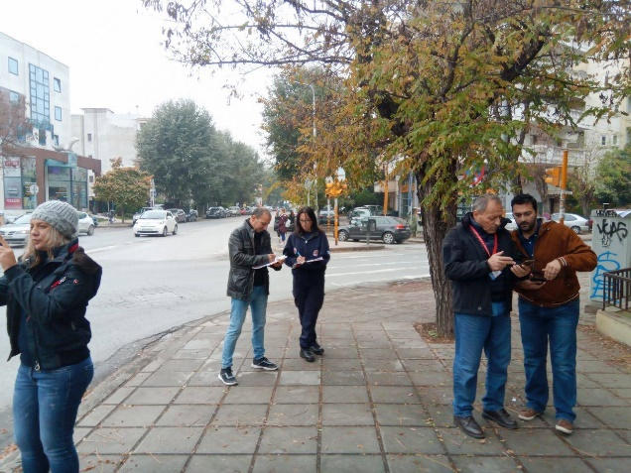
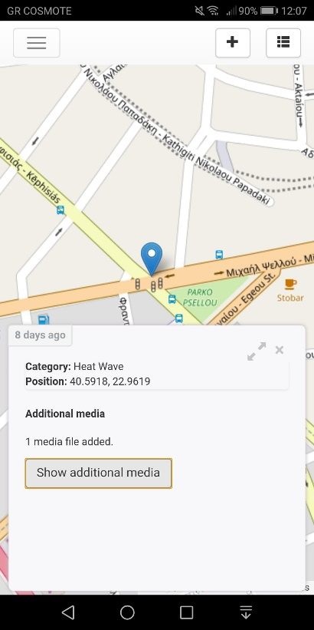
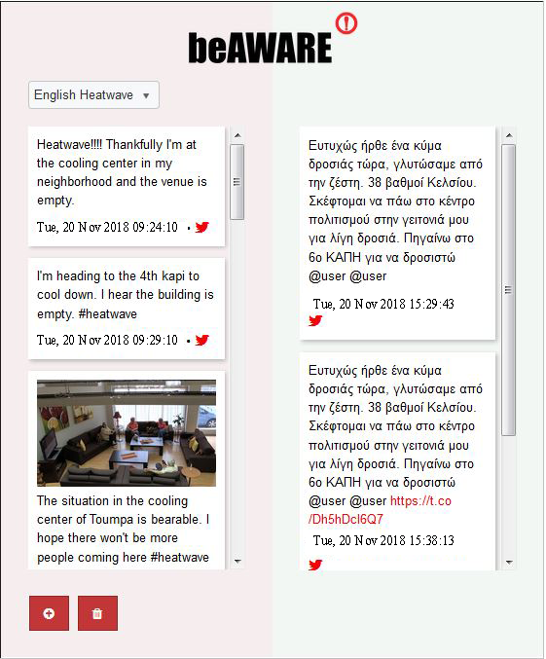
Session 2 – beAWARE
Add incident point on map

Slide 25
Session 3 – Places of Relief
Storyline
  Heatwave at high peak, PSAP direct citizens to Relief Places.
  Rescuers help citizens to go to Relief Place and manage it.
  With Legacy Tools
  From PSAP to citizens and Relief Place: press releases, email and telephone communication
  From PSAP to Rescue Teams: email, telephone and VHF communication
  With beAWARE platform
  Voice, Image and Video messages from citizens to PSAP
  PSAP send tasks to Rescuers

Slide 26
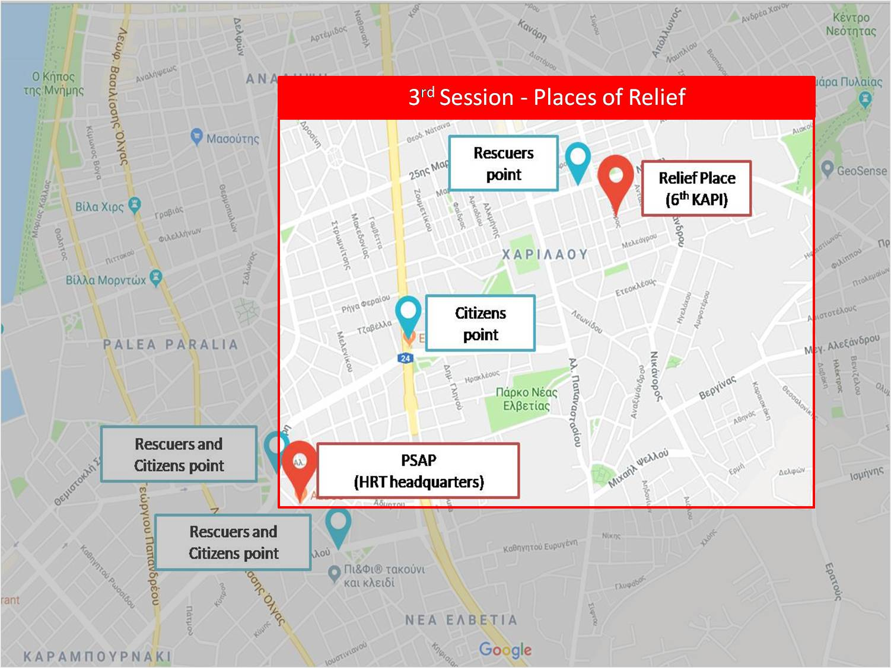
Session 3 – Map Area

Slide 27
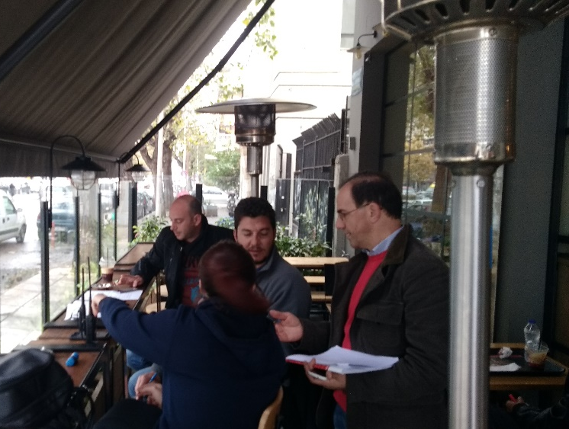
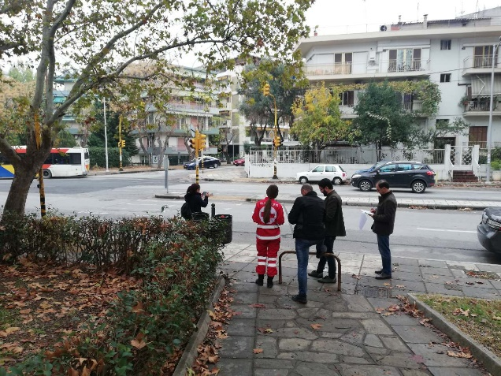
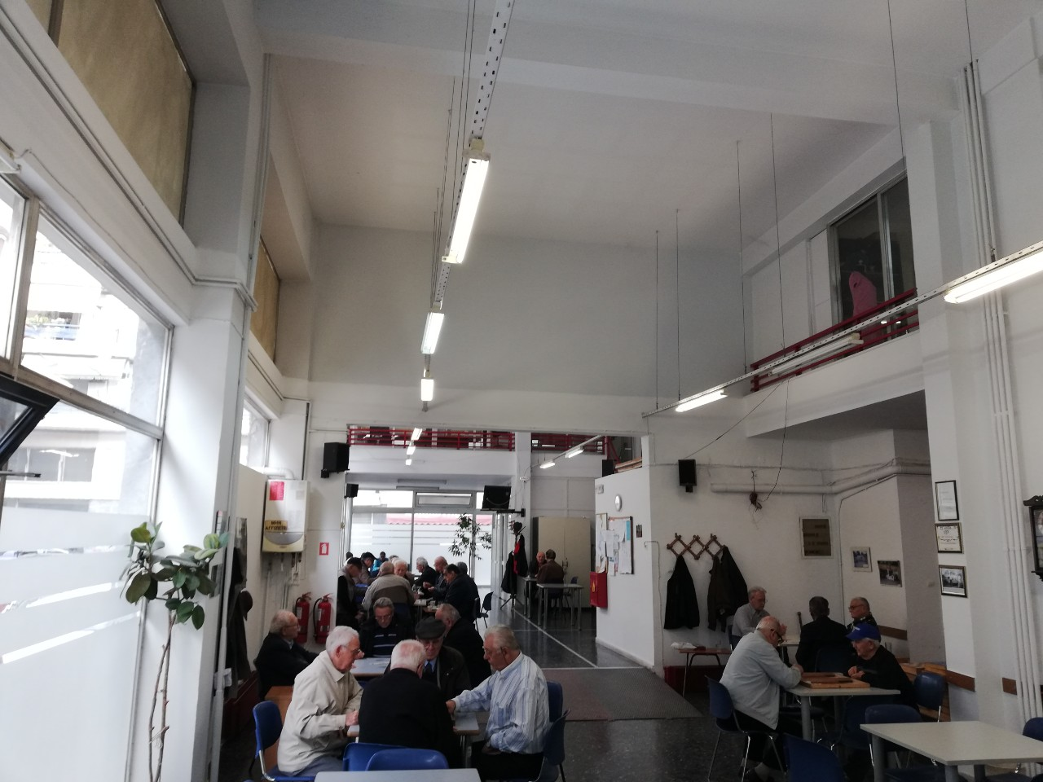
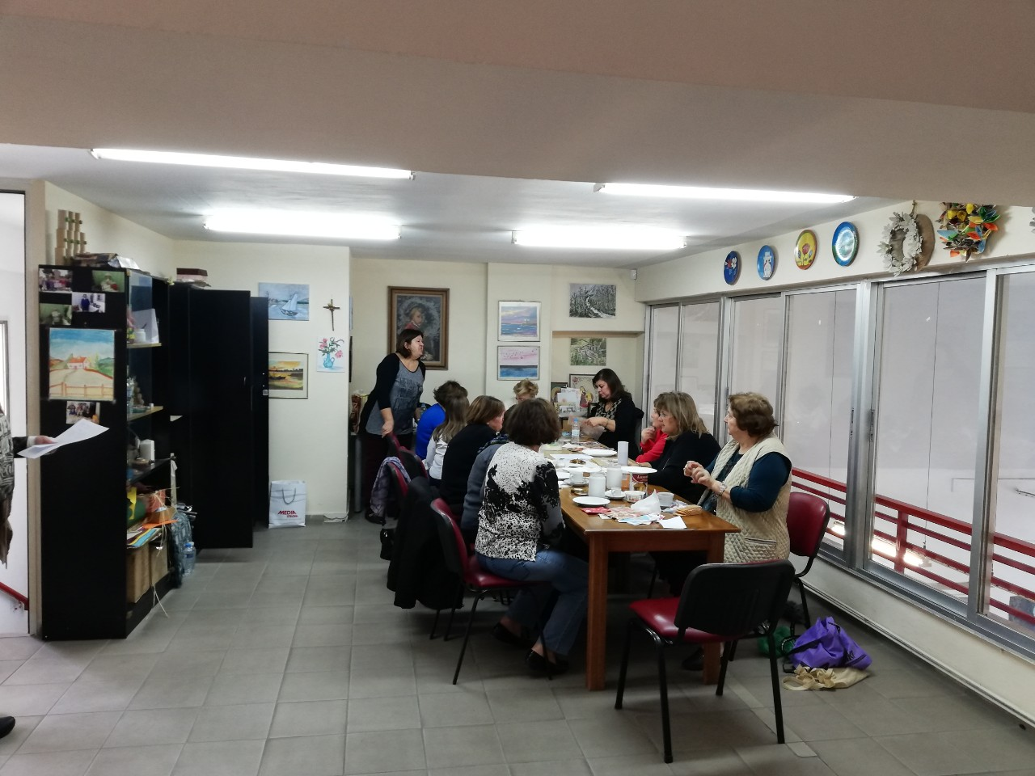
Session 3 – Legacy Tools

Slide 28
Session 3 – beAWARE

Slide 29
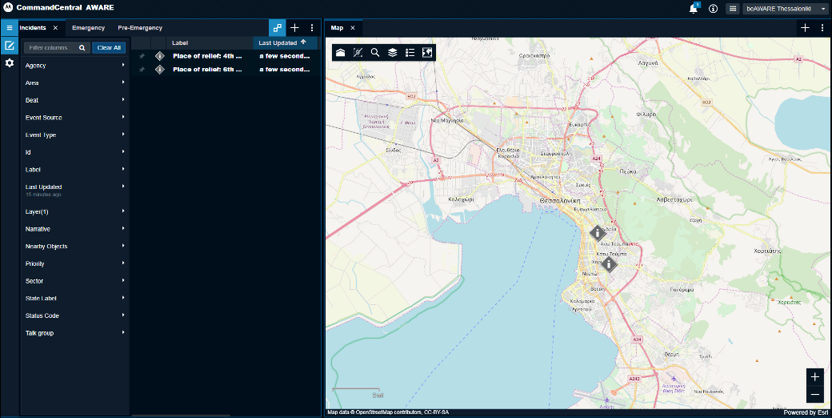
Session 3 – beAWARE
Two places of relief are illustrated on the PSAP

Slide 30
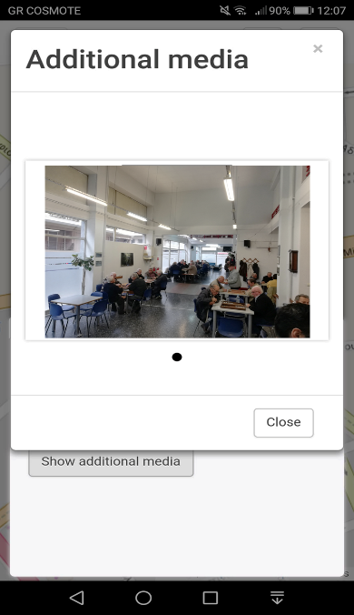
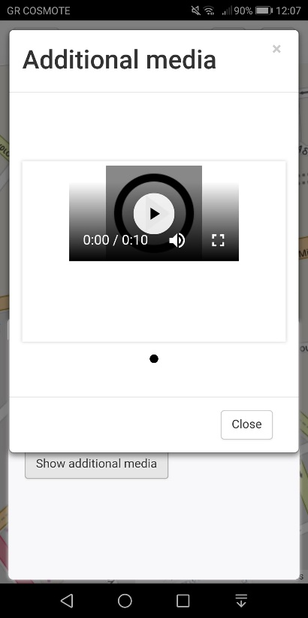
Session 3 – beAWARE
Add media files for incidents
Add incident point on map

Slide 31
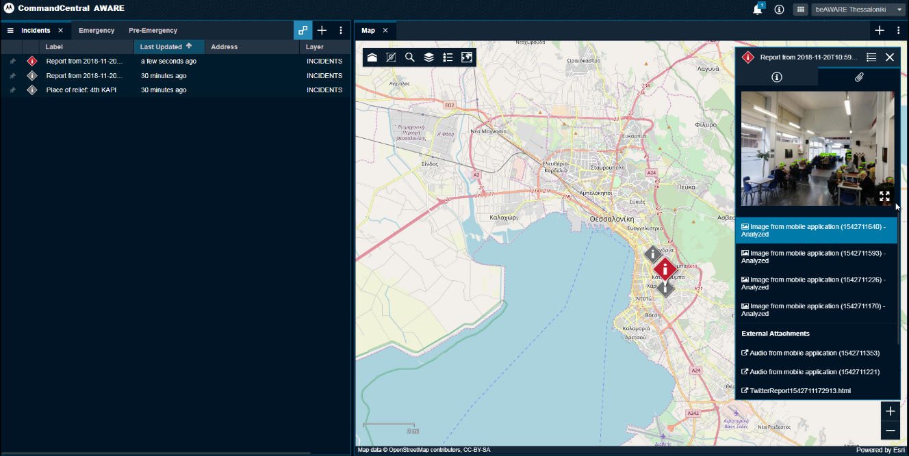
Session 3 – beAWARE
Cluster report from the place of relief. beAWARE system gathers the incidents that are reported within a specific radius under a common spatial cluster.
The illustrated cluster contains 4 image reports, 2 audios and a twitter report all referred to the 6th KAPI cooling shelter.

Slide 32
Observation Sheets and Questionnaires Evaluation
Communication problems with legacy tools.
beAWARE helped to overcome issues noticed with legacy tools, such as bad radio signal, interference and misunderstanding
Overall evaluation was positive, especially due to the fact that beAWARE system provides information in real time

Slide 33
Conclusion
The successful completion of the heatwave pilot gave a significant boost to all beAWARE team and with the key-notes from the evaluation, the future steps.
The continuation and success of the project is based on the development of the platform, through a successful evaluation.
Mutual understanding and cooperation between all members of the consortium, reflected to a successful pilot implementation and in the constant evolution of the beAWARE system.

Slide 34
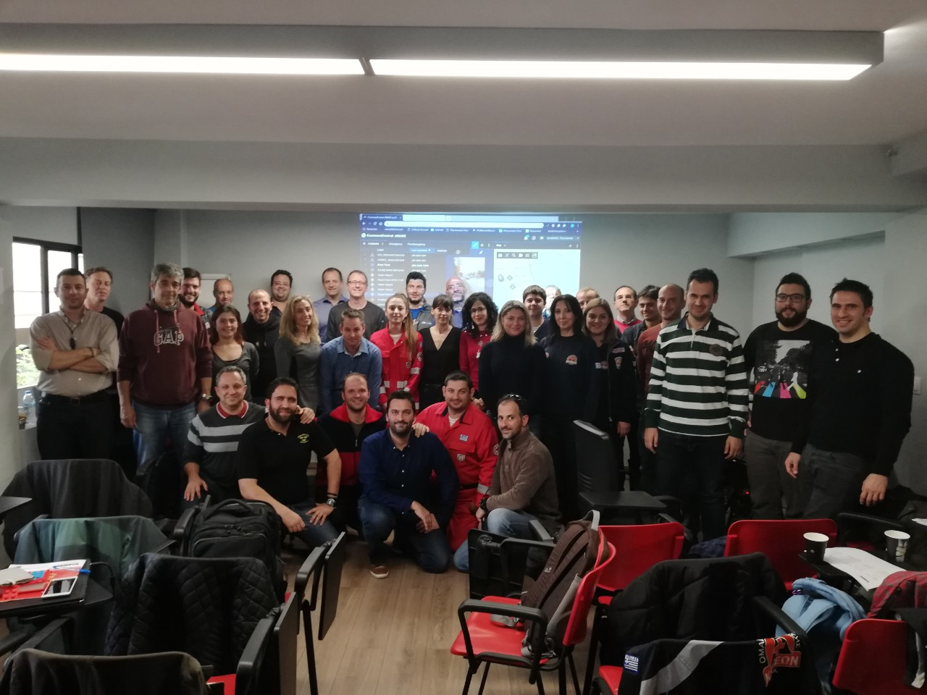
Thank you!

